Slide 1
NAAN MUDHALVAN SCHEME FUNDAMENTALS OF DATA ANALYTICS WITH TABLEAU
PROJECT TITLE: UNVEILING MARKET INSIGHTS
TEAM ID:NM2023TMID16084

Slide 2
Team lead ID:0A396DCED1054E59B3045AE7BC899098
Team members ID:
70313CDB6F5E9FFA92A463F4728D5AF5
C75E72152839B2E8AD344B0AA7AF96D6
BF0A7D458BA88AF81E247599CE250271

Slide 3
Introduction
Wholesaling or distributing is the sale of goods to retailer to industrial, commercial, institutional or other professional businessman to other wholesalers (wholesale businesses) and related subordinated services. Wholesaling is buying goods in bulk quantity, usually directly from the manufacturer or source, at a discounted rate. The retailer then sells the goods to the end consumer at a higher price making a profit.

Slide 4
The consumption and production of marketed food are separated.Production is primarily in rural areas while consumption is mainly in urban areas.In today’s highly competitive business landscape, gaining deep market insights is essential for businesses to thrive and grow

Slide 5
Empathy map

Slide 6
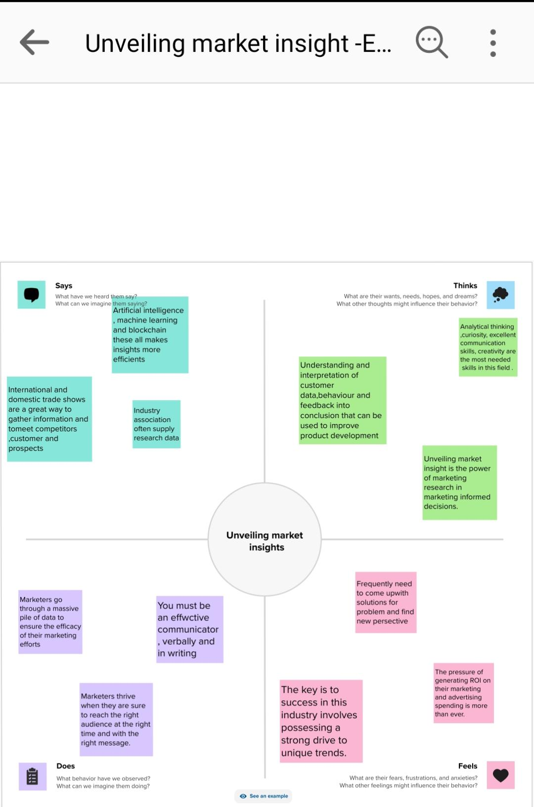

Slide 7
BRAINSTORMING MAP

Slide 8
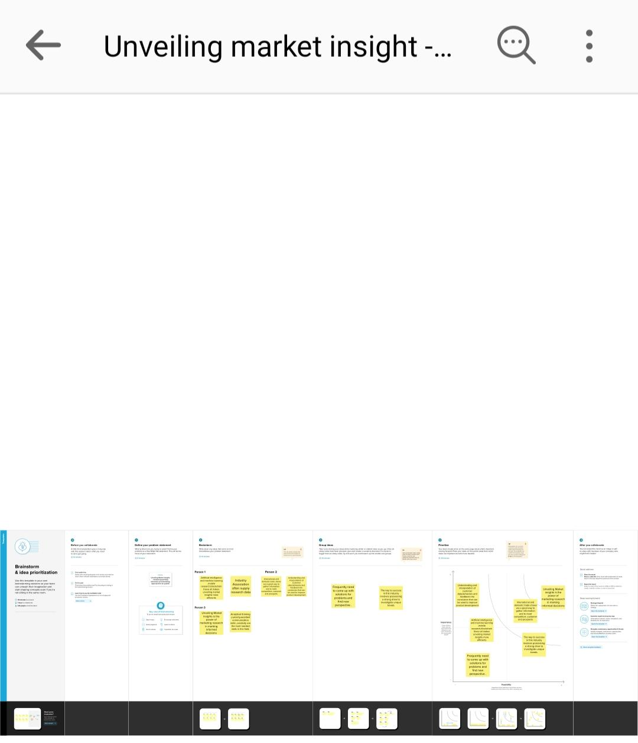

Slide 9
Results

Slide 10
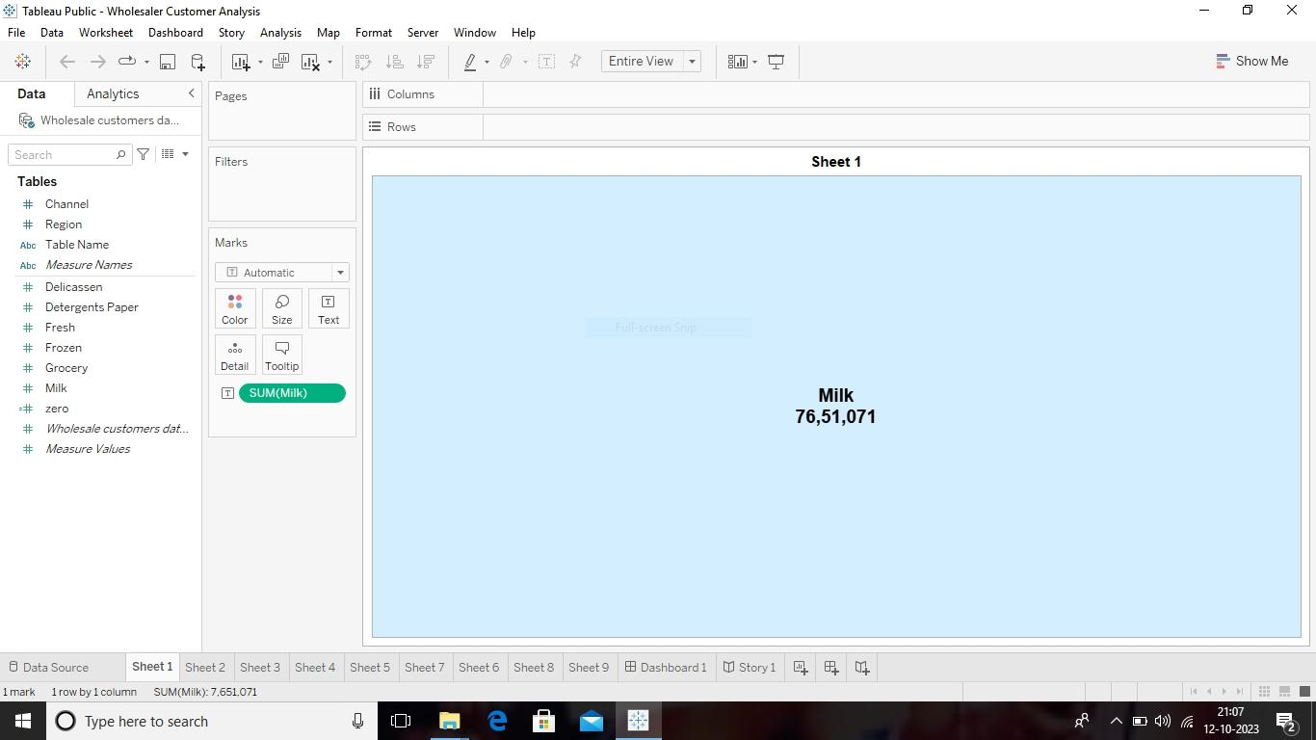
Sheet 1

Slide 11
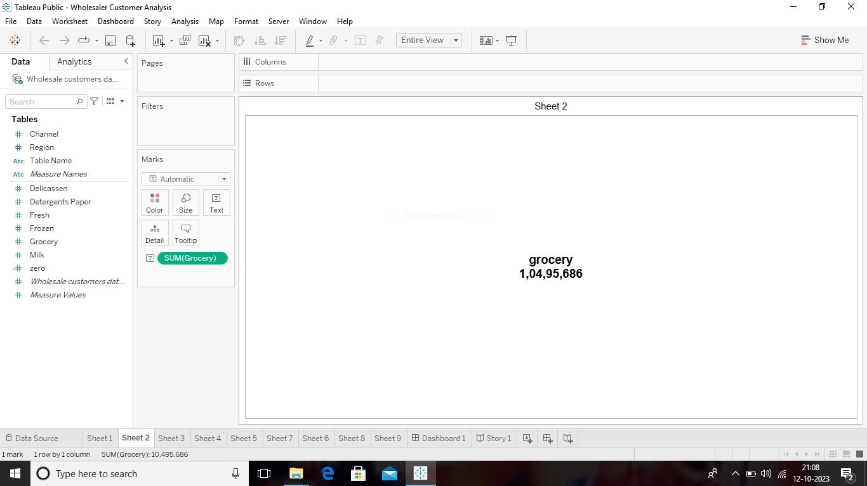
Sheet 2

Slide 12

Sheet 3

Slide 13
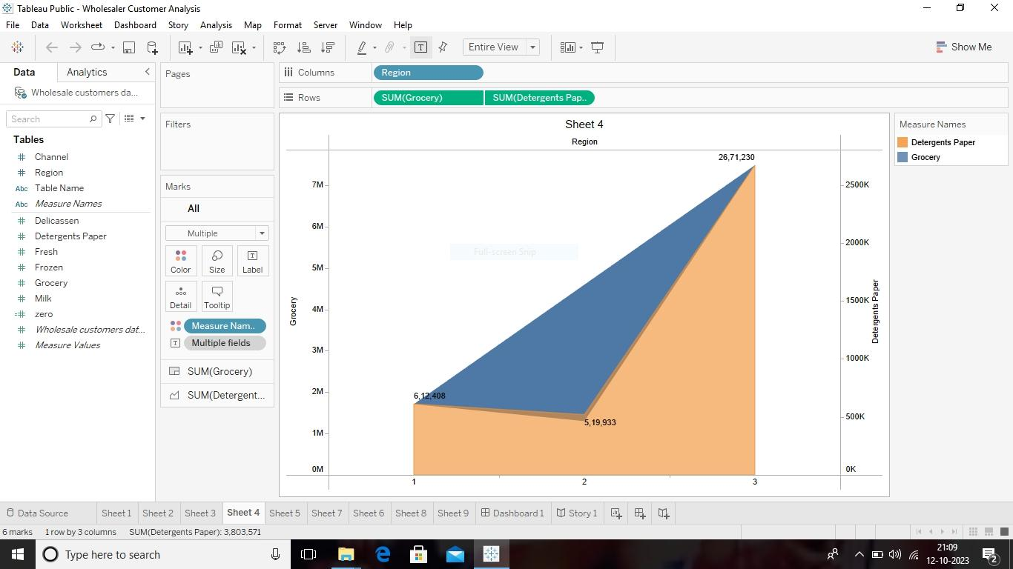
Sheet 4

Slide 14
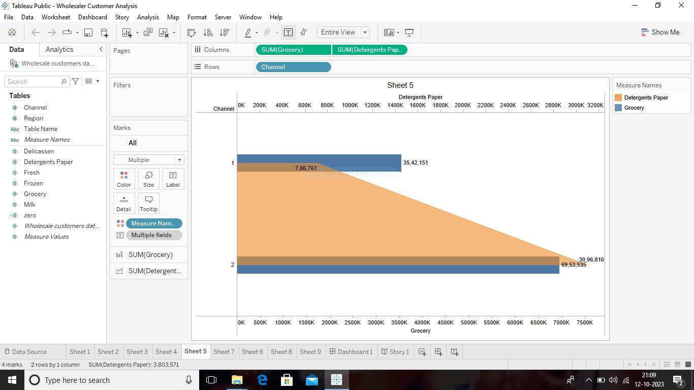
Sheet 5

Slide 15
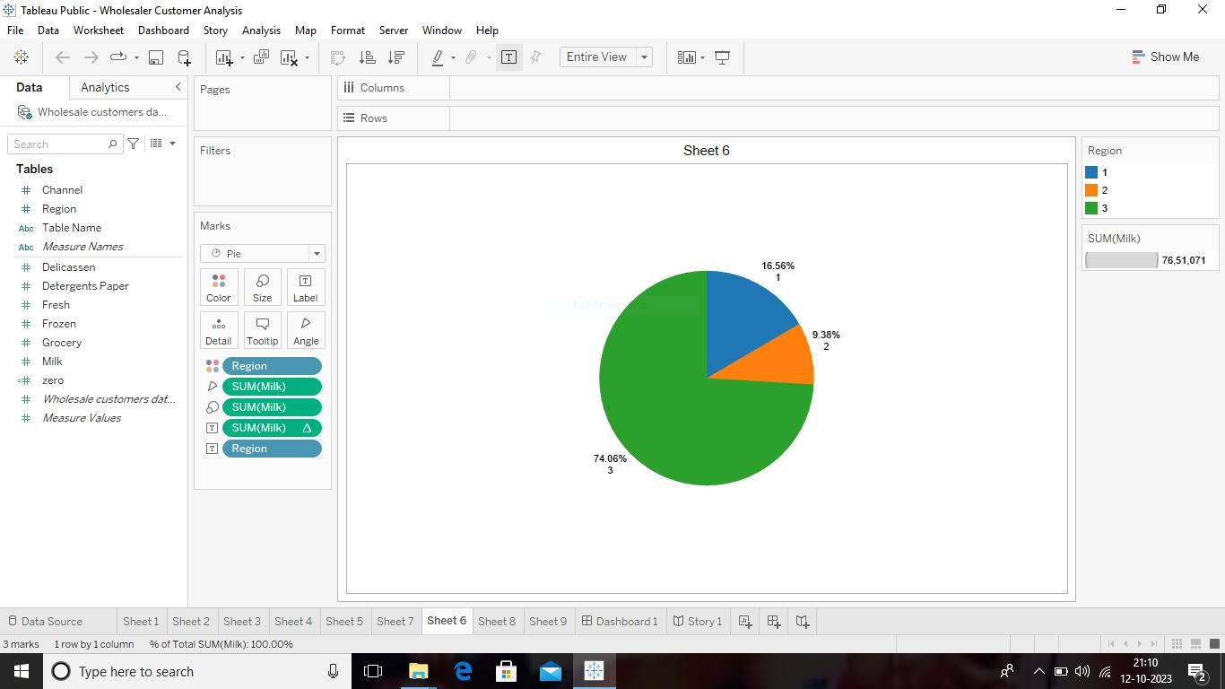
Sheet 6

Slide 16
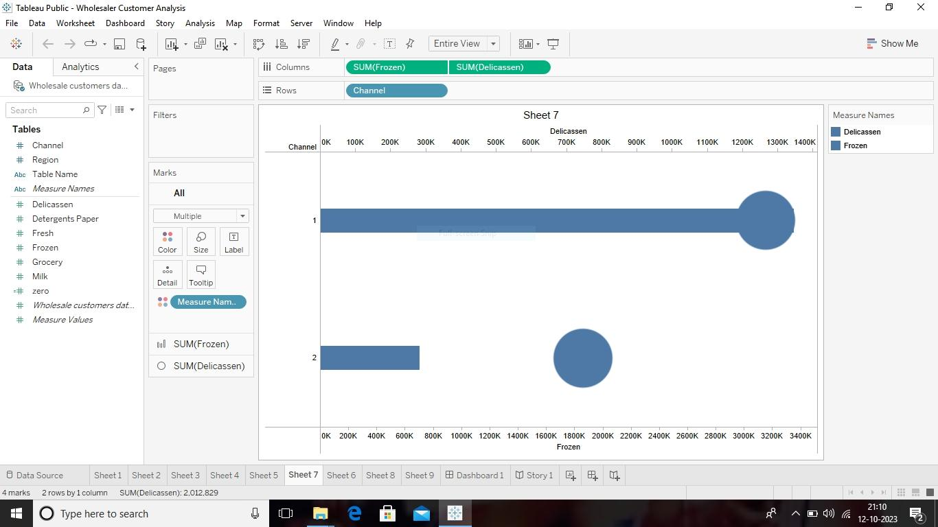
Sheet 7

Slide 17
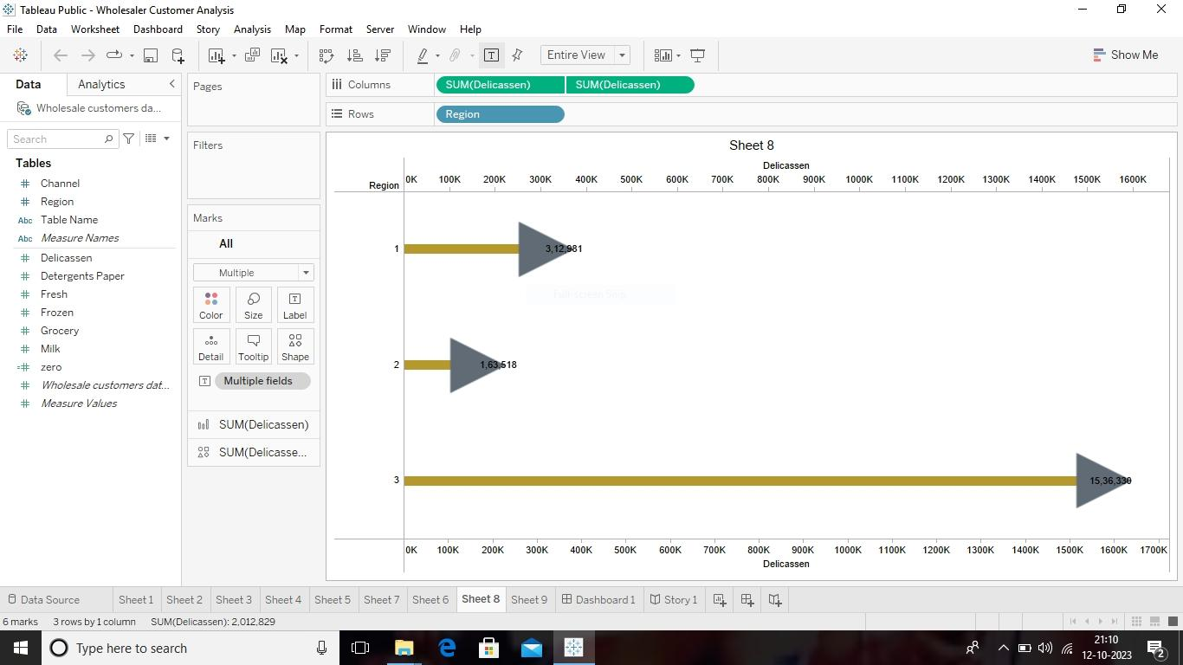
Sheet 8

Slide 18
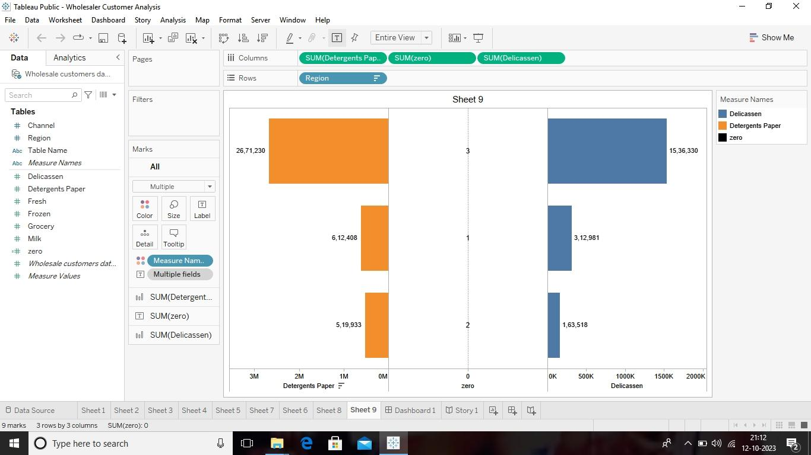
Sheet 9

Slide 19
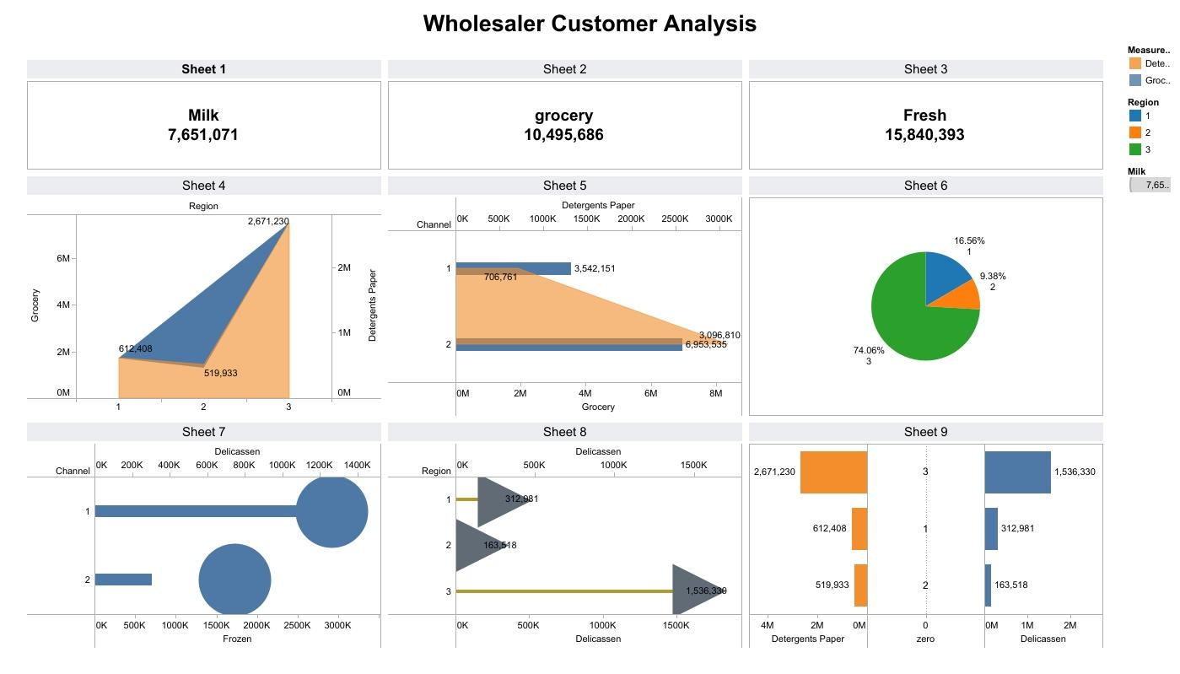
Dashboard

Slide 20
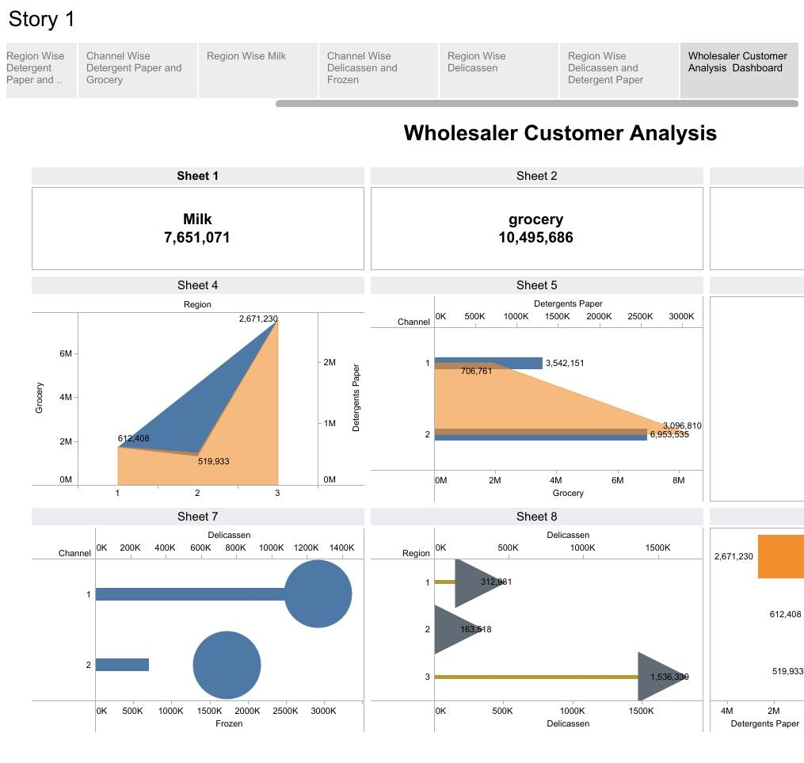
Story

Slide 21
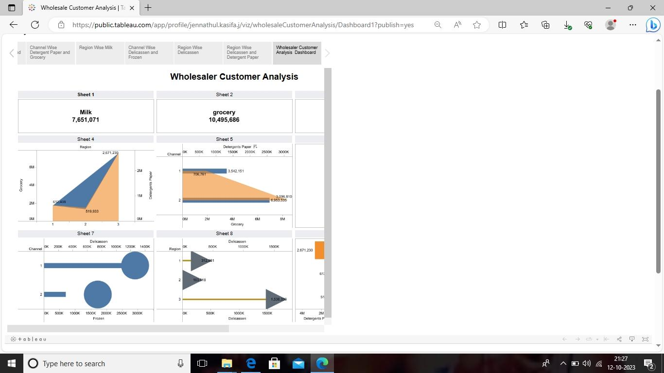

Slide 22
Advantages and Disadvantage

Slide 23
Advantages
Tableau is scalable and can be used for both small and large datasets making it suitable for businesses of all sizes.
It supports collaboration through sharing and publishing dashboard, allowing teams to work together on market insights.
You can customize dashboard and reports to fit your specific market research needs.
It can handle real time data ensuring you have up to the minute insights for quick decision making
Tableau can connect to a variety of data sources, enabling you to integrate and analyze data from different platforms and databases

Slide 24
Disadvantage
Tableau desktop is a popular choice for market insights due to its powerful visualization capabilities,but it comes with costs and potential challenges in handling very large datasets and predictive analytics.

Slide 25
Application
Sales analysis
Customer segmentation
Market share analysis
Product performance
Market research visualization
Price optimization
Inventory and supply chain analysis

Slide 26
Conclusion
This project aims to analyze the customer spending behaviour and identify opportunities for growth by leveraging data analytics and data driven decision making.
The primary objective of this project is to understand customer pattern, preference, and trends across various dimensions. By conducting a comprehensive analysis, businessess can optimize their marketing strategies,improve product offerings ,and enhance customer engagement to drive revenue growth.
Finally the processes which have been done by team is published on tableau.The video of our project is demonstrated.The project report is given above .we have a clear dashboard and story which are to be easily understood.

Slide 27
FUTURE SCOPE
This project gave as a guidance to get a job to this field in a software companies.we may be analysis in our life

